Slide 1


TECHNOLOGIES PVT. LTD.

Slide 2

WHO WE ARE
We do things better
Our comprehensive services will help you make a success online. Aviox Technologies is a continuously growing company presenting its commendable services. You can count on us as we have an elite professional team with all the skills necessary for working. We help organizations to makeover their business with new technologies to fast track their way of success. So, let your brand undergo digital innovation. We are extraordinary when it comes to various services offered by us and, with our skills and hard work, and services, await nothing less than best.

Slide 3

Our Key Value Pillars
TECHNOLOGIES PVT. LTD.
Innovation in Ideas
Strategy in Execution
Excellence in Delivery
Satisfaction in Clients
Technology is moving at an incredible pace, and we also need to stay updated with it. Our team of professionals keeps applying innovative ideas
Our team focuses on crafting smart web solutions with appropriate research-backed strategies, including creative designs, development, and post-maintenance.
Our prime focus is on effective service delivery and escalation management services to generate customized services for our clients.
Providing satisfactory results to the clients is on the hot high priority for us. We have a vast clientele that is super satisfied

Slide 4






WHAT WE DO
Back End Technologies
Mobile Application
Front End Technologies
IOT
Digital Marketing
Python, and PHP are popular Back End languages to develop and maintain the Back End logic that efficiently pulls the data to fulfill a request of the user.
Get the most elegant and efficient solutions built on proven methodologies! In today's era, mobile apps have taken an immortal place.
With the increasing trends, we offer a front end with best HTML5, CSS, and JavaScript for creative design services to cater to your business needs which ensures a great user experience
Leveraging Big Data, Analytics, Machine Learning, Artificial Intelligence, and other disruptive technologies, to glean tangible insights from this deluge of information.
Digital Marketing is must for all the businesses. We, as a Digital Marketing company, deliver the highest-quality for all the categories. We have worked with top brands, companies of all sizes and start-ups to build exceptional from an idea.

Slide 5




BACK END TECHNOLOGIES
Python
PHP
Node JS
Our Python development services are counted among the best custom python web framework companies in India. We offer a wide array of app development services that include custom python development solutions
Php Frameworks is must for all the businesses. We, as a Web Development company, deliver the highest-quality Web Development for all the categories. We have worked with top brands, companies of all sizes
One of the finest Node Js MVC framework companies that adhering to the features as per the client's requirement & positive approach to deploying the eye-catching services with post-maintenance and support.

Slide 6





Python Framework
Django
Webapp2
Python framework that enables developers to generate complex code and develop applications quickly.
Webapp2 adds better URI routing and exception handling, a full featured response
FastAPI
Web2py
Fast API framework is a fast, modern, and high-performance web framework with Python.
Web2py allows web developers to program dynamic web content using Python.
Flask
Flask is a minimal web framework usually used in simpler web application

Slide 7



Python Tools
1
Django
2
FastAPI
Python framework that enables developers to generate complex code and develop applications quickly.
Fast API framework is a fast, modern, and high-performance web framework with Python.
3
4
Flask
Web2py
Flask is a minimal web framework usually used in simpler web application
Web2py allows web developers to program dynamic web content using Python.
5
Web2app
6
Django RF
Webapp2 adds better URI routing and exception handling, a full featured response
Flexible toolkit for building Web APIs. Authentication policies including packages for OAuth1a and OAuth2.
7
Dash
8
Python AWS
Python framework for building web analytic applications, data visualization apps with highly custom user interfaces
Boto3 makes it easy to integrate your Python application, library, or script with AWS services

Slide 8





Laravel Development
We are backed by a team of zealous Laravel developers who are proficient in developing innovative apps with elegant design at high speed.
Yii Development
We have a core team of professionals generating a high-performance component-based PHP framework suitable for all web applications.
PHP Framework
Codeigniter
Codeigniter PHP framework is a mature and reliable platform that is a perfect choice for developing large scale enterprise projects.
CakePhp Frameworks
With CakePHP Framework, our skilled professional develops and provides a feature-loaded and visually impressive solution for your digital needs.
8

Slide 9


FRONT END TECHNOLOGIES
UI/UX
With the increasing trends, we offer a full stack of creative design services to cater to your business needs. Get hold of the best creative solutions for all your business needs and make your success online with us.
MVC Framework
MVC Frameworks are the libraries that can be incorporated beside the JavaScript to endow with a layer of abstraction on the top of the core language. The primary goal of JavaScript MVC frameworks is to facilitate structuring the codebase
CMS Framework
Aviox Technologies customized CMS development solutions are success-driven, SEO friendly, and are deliberated to integrate with the currently existing solutions to augment and lift your online handles. Our CMS developers are proficient in customizing and building CMS solutions for all types of industries.

Slide 10





UI/UX Designing
Responsive Design
Mobile App Design
By connecting for the modern alternatives, reward yourself with a beautiful domain with high-resolution graphics and fluid images to attract the audience. With our responsive website design services, keep your brand intact across all the devices, ensuring that every web page displays as anticipated on every screen.
We believe that a mobile application's design can attract your target audience and convert them to ideal clients. Being a top-rated mobile app design company, experience the best with us by minimizing the cognitive load and optimizing the user flow.
Design Prototype
Front End Development
By incorporating the recent technologies into our design services, we try our best to design and deliver an extraordinary and inventive outcome in our UI/UX design.
We have sufficient experience on the market, and with the experience of working in the field, we have productively delivered projects that are well-designed and meet business needs. We rely on proven frameworks and technology and are dedicated to deploy the final products with a functional and efficient user-friendly front-end.
10

Slide 11






UI/UX Designing Tools
Webflow
CorelDRAW
Adobe Photoshop
Figma
Adobe XD
Adobe Illustrator
11

Slide 12



MVC Frameworks
React JS
React Js framework is an open-source JavaScript library for developing user interfaces for mobile applications or single-page apps. Our React JS Development services primarily focus on providing simplicity, scalability, and speed.
Knockout JS
With our experienced and skilled Knockout JS developers team, we facilitate responsive applications with a clean underlying data model and a rich display.
Vue JS
Our experienced team of techies offers Vue.js development services that combine best in class designs with efficiency. Vue Js framework is a progressive javascript framework for developing interfaces and single-page applications.
Angular JS
With the Angular Js MVC, we could develop and deploy faster than usual, and we recommend Angular Js to our clients to improve their legacy systems. To their surprise, they are delighted with the technology upgrades.

Slide 13



CMS Frameworks
Business enterprises and developers mostly use the WordPress platform. Get the customized website development services with our experts. .
WordPress Websites
Joomla
Websites
Aviox Technologies offers full-fledged Joomla Web development services by delivering customized and feature-rich services to clients.
With specialized team- Drupal CMS developers, We strives to provide you the most satisfactory web solutions that exceed your expectations.
Drupal CMS

Slide 14


Mobile Application
IOS App
If you have a vision for getting a high-valued product delivered, we would love to bring your ideas and innovation to life. Being a full-stack iOS applications development service provider, we have developed and deployed several iOS solutions.
Android App
Being a top app development company, we execute a strategy to provide viable solutions, uplifting your development strategy, designing the seamless experience, and developing the applications that add an unmatched value to users' lives.
React Native/Flutter App
Being a leading React Native app development company, we follow incredibly sophisticated methods and approaches in successfully deploying the hundreds of innovative solutions globally.

Slide 15



Internet Of Things (IOT)
Communication
A host of network protocols for the internet has made it easy to connect sensors to the cloud and to other “things” for efficient data transfer.
Machine learning
Vast amounts of data stored in the cloud, businesses can gather insights faster and more easily. Data produced by IoT also feeds these technologies
SaaS IoT Applications
Business users can quickly enhance existing processes for supply chains, customer service, human resources, and financial services. There’s no need to recreate entire business processes.

Slide 16





Digital Marketing
SEO
SMO
PPC
ORM
Making an impact to your online presence. For the better ranking on Google and organic traffic to your website with increasing CTR and Leads Generation.
To engage the audience on your social media accounts and keep increasing your reach to the larger audience and region to get most of it.
You online presence matters the most that’s why we are keep digging and improving your brand value in online marketing.
Direct increasing in audience and bid strategy to the relevant keyword. Creating attractive ads copy and managing ad groups.

Slide 17

PYTHON
PROJECTS

Slide 18
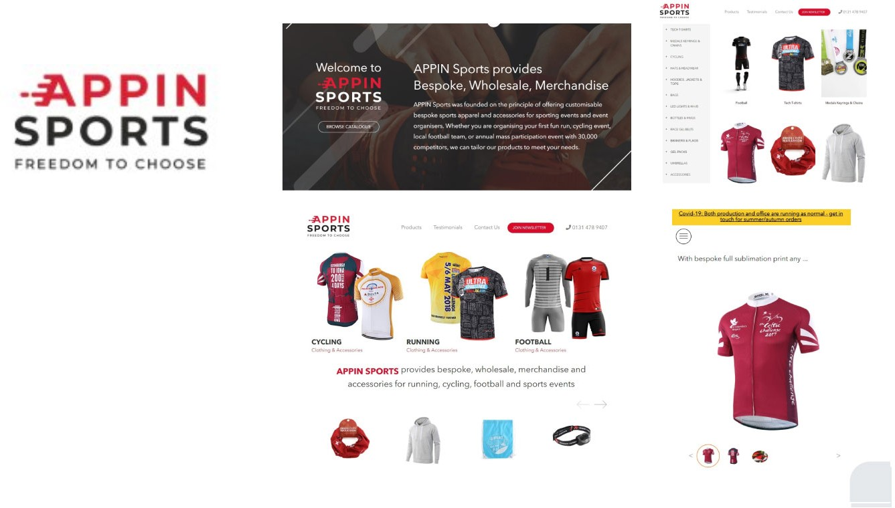
PROJECT #1
APPIN SPORTS
APPIN Sports
E-commerce
We created the website using Python/Django framework with front end HTML5, CSS3, JavaScript, jQuery and Bootstrap Framework. Appin Sports is an e-commerce platform which provides you sports related clothing and accessories.

Slide 19
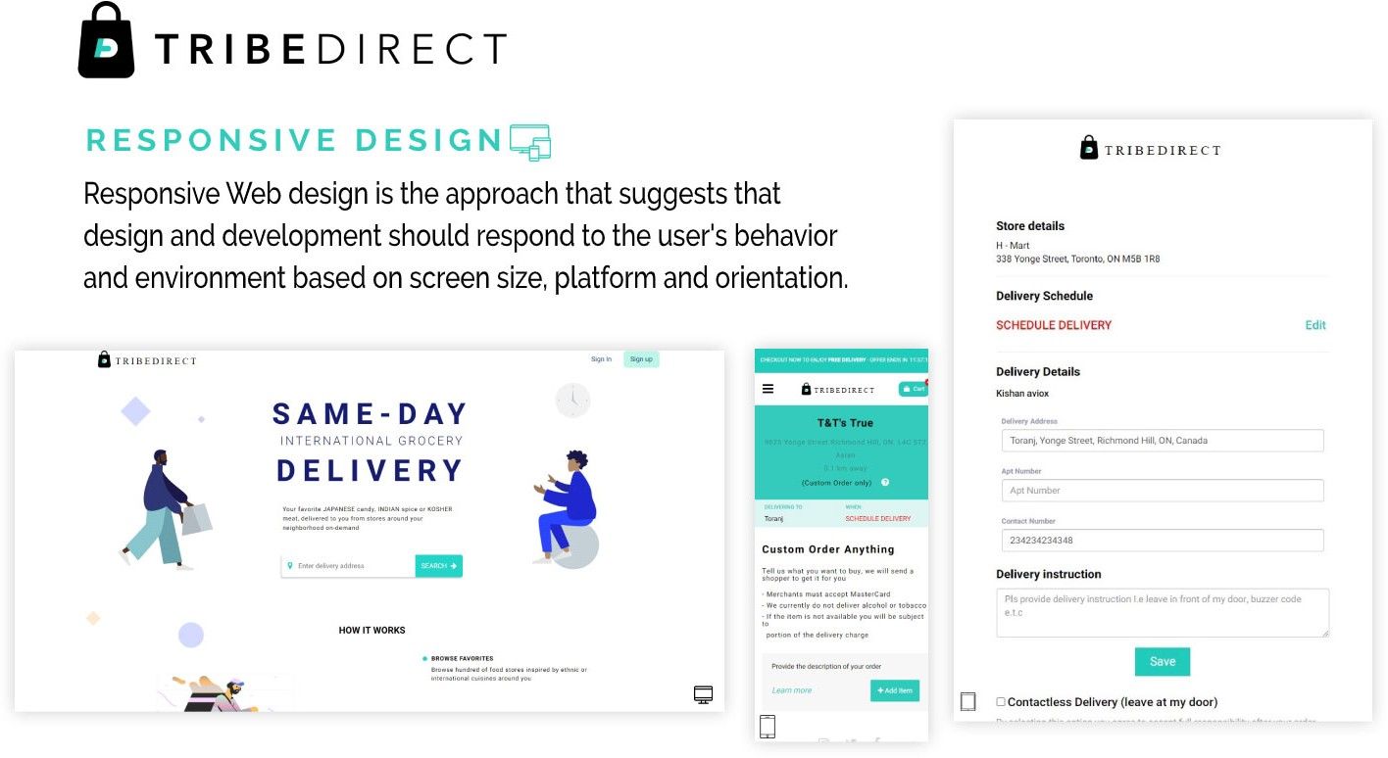
PROJECT #2
TRIBEDIRECT
Tribedirect
E-commerce
We created the website using Python/Django framework with front end HTML5, CSS3, JavaScript, jQuery and Bootstrap Framework. Appin Sports is an e-commerce platform which provides you sports related clothing and accessories.

Slide 20
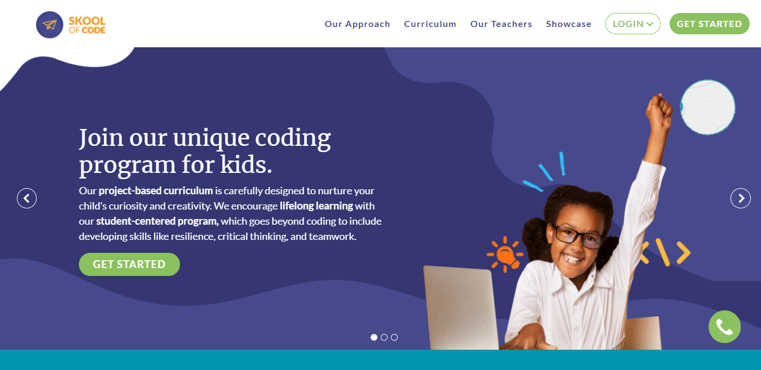
PROJECT #3
SkoolOfCode
SkoolOfCode
Education
Skool of Code offers children registration for learning, we build the website with python using front end JavaScript, jQuery that gives the immersive experience to enjoy study.

Slide 21
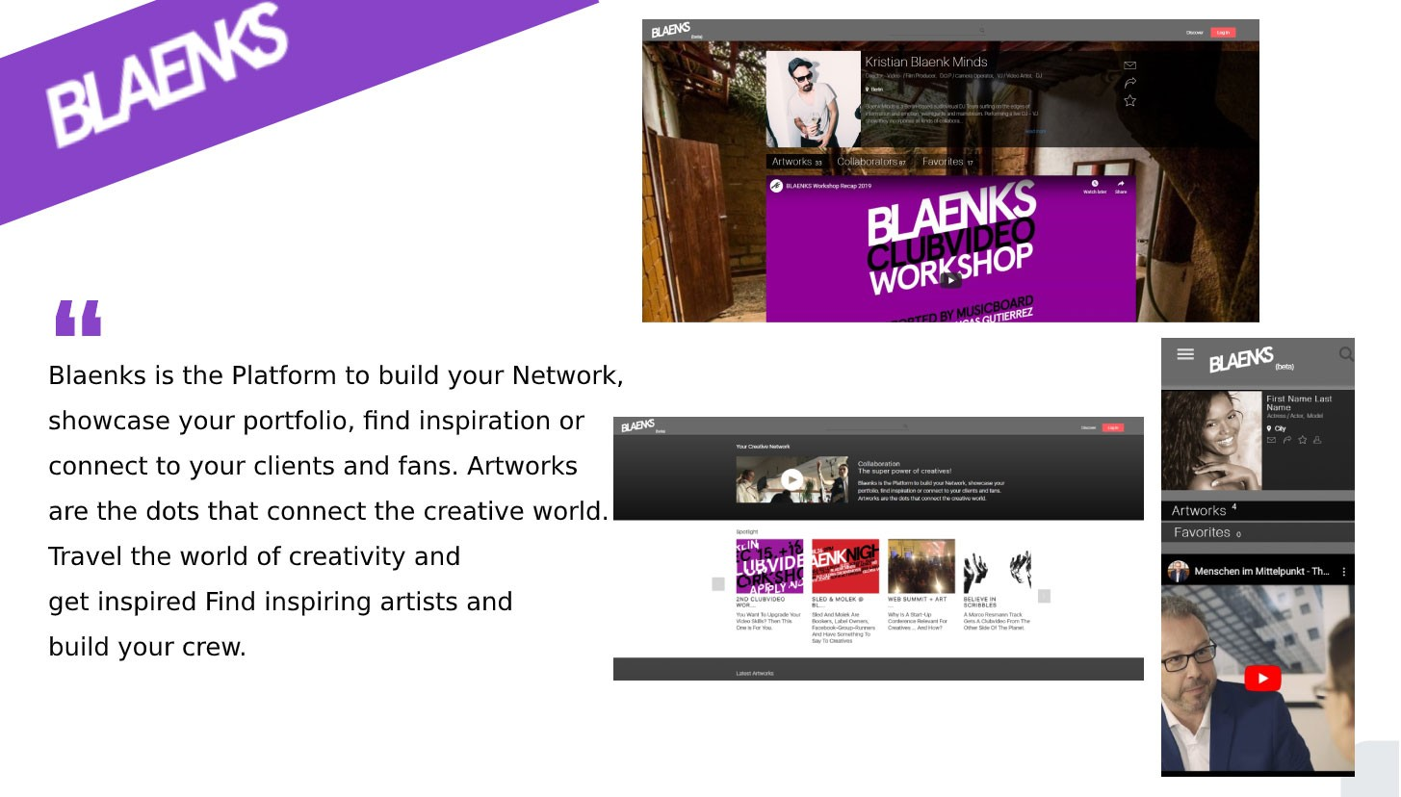
PROJECT #4
BLAENKS
Blaenks
Entertainment
Blaenks is the Platform to build your Network, showcase your portfolio, find inspiration or connect to your clients and fans. Simple website is created by JavaScript and python. Getting most of it is the best experience to the user.

Slide 22
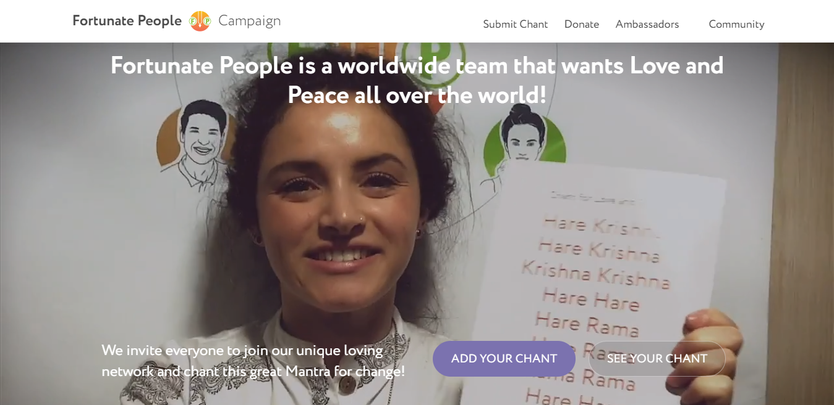
PROJECT #5
Fortunate People
Fortunate People
Entertainment
This platform is to enhance a person's positivity by posting chants videos. We gave them the platform to embrace their motive to reach more people. Get straight to the spiritual fun of sharing the Maha-Mantra with others. You can unplug at any time.

Slide 23
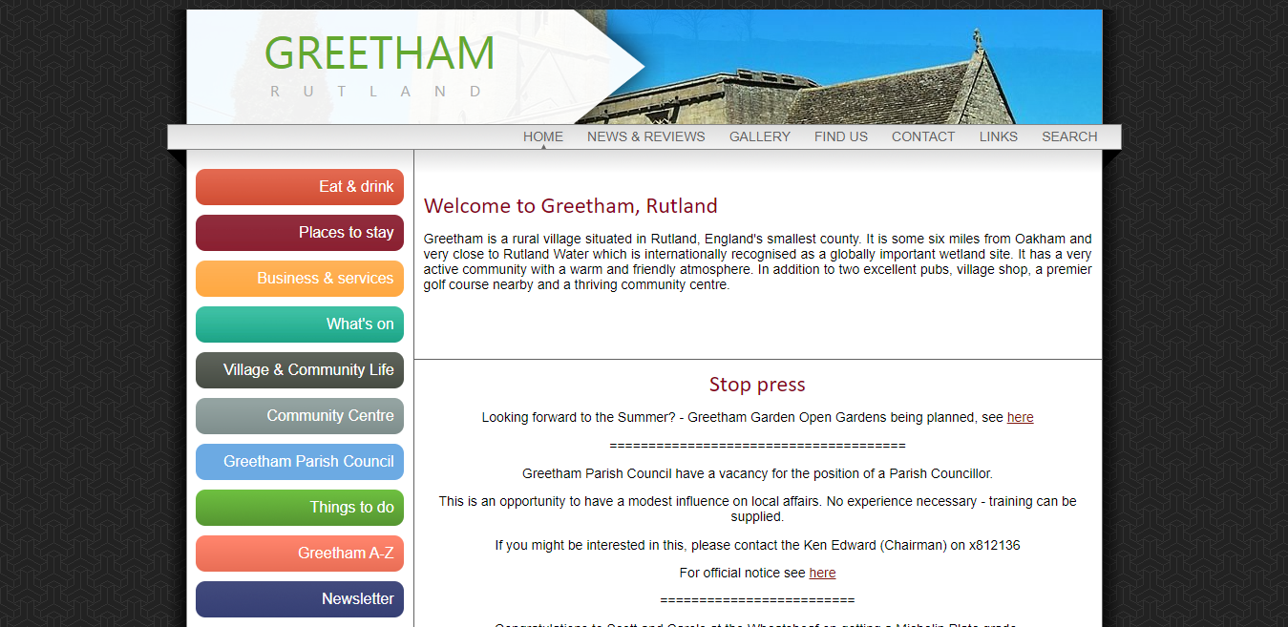
PROJECT #6
Greentham
Greentham
Entertainment
This is the informational website with the latest Greentham news. Rutland information service allows users to search and read information about the area.

Slide 24
PHP
PROJECTS

Slide 25

PROJECT #1
MFHA Performance
MFHA Performance
Remaining
This website we designed and developed deals with events for the horses. Using the latest PHP frameworks making it responsive and running on each device’s screen. We helped with Server data handling and functionality.

Slide 26
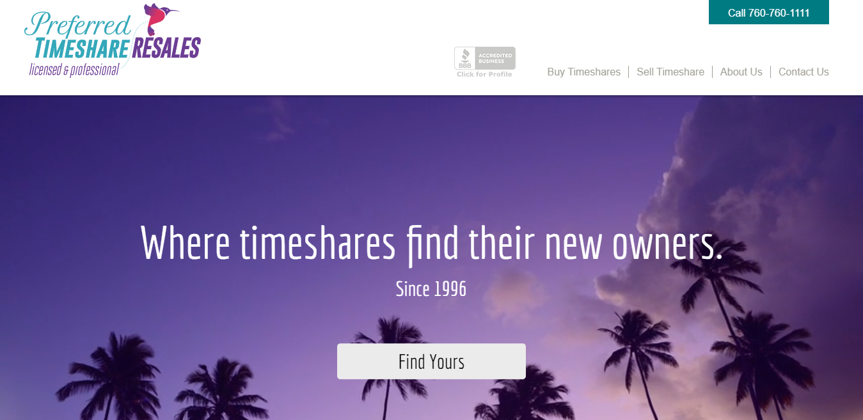
PROJECT #2
Preferred Timeshare Resale
Preferred Timeshare Resale
Real Estate
This website we designed and developed deals with events for the horses. Using the latest PHP frameworks making it responsive and running on each device’s screen. We helped with Server data handling and functionality.

Slide 27
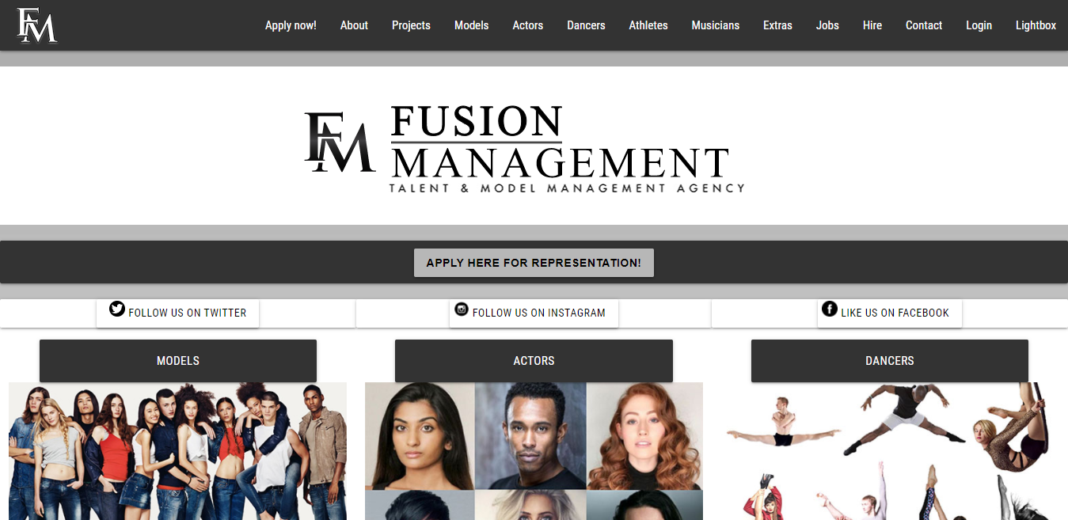
PROJECT #3
Fusion Management
Fusion Management
Talent Management Agency
Fusion Management is a model management agency having 10 years of experience. They need a platform where one can select the talent and apply for the talent acquisition also. We provided the best solution to acquire the needs.

Slide 28
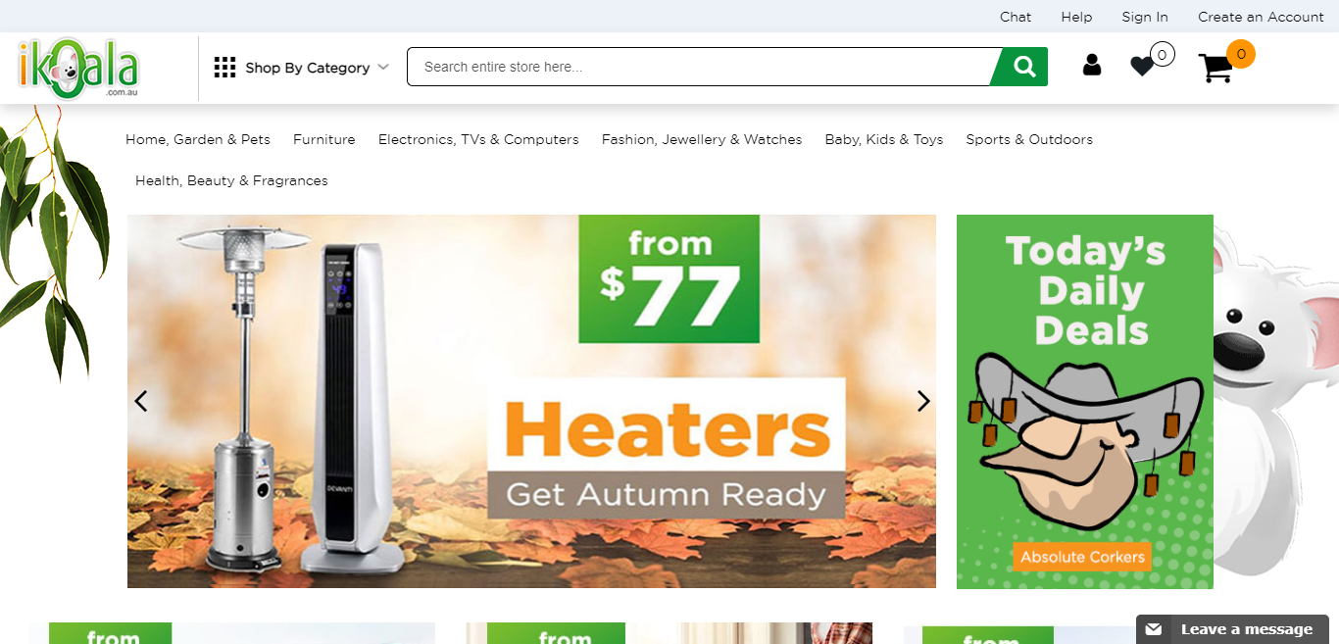
PROJECT #4
iKoala
iKoala
E-Commerce
E-commerce website for home appliances, furniture, jewelry, toys and beauty products. iKoala is subjected to the highest standards of product quality, purity assurance, and sustainability practices which is highly organized & extremely productive.

Slide 29
MVC Framework
PROJECTS

Slide 30
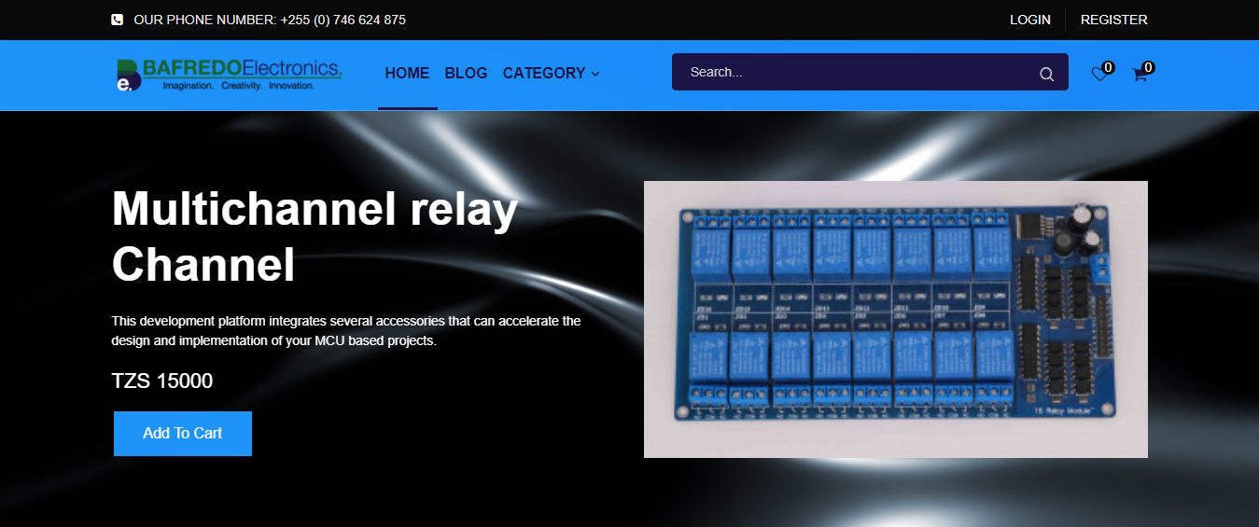
PROJECT #1
Bafredo Electronics
Bafredo Electronics
E-Commerce
This development platform integrates several essential accessories that can speed up the design and implementation of your project.

Slide 31
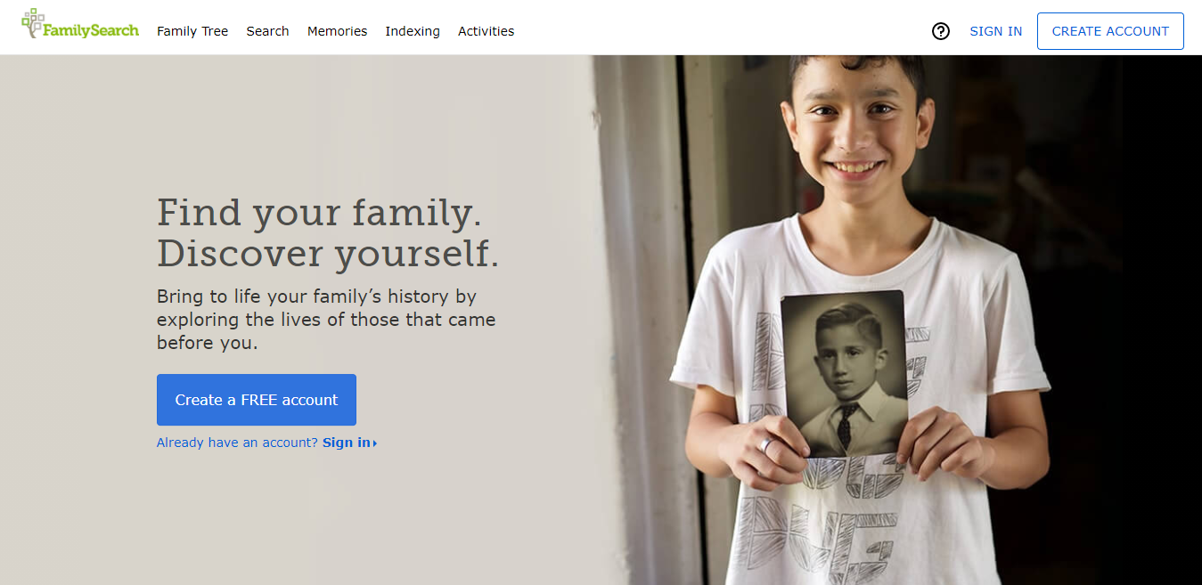
PROJECT #2
Family Search
Family Search
Genealogy
Family Search is the better way to create a family tree. We helped them create the elaborative Logo and website design. You can search your ancestors with some details and create a family tree.

Slide 32
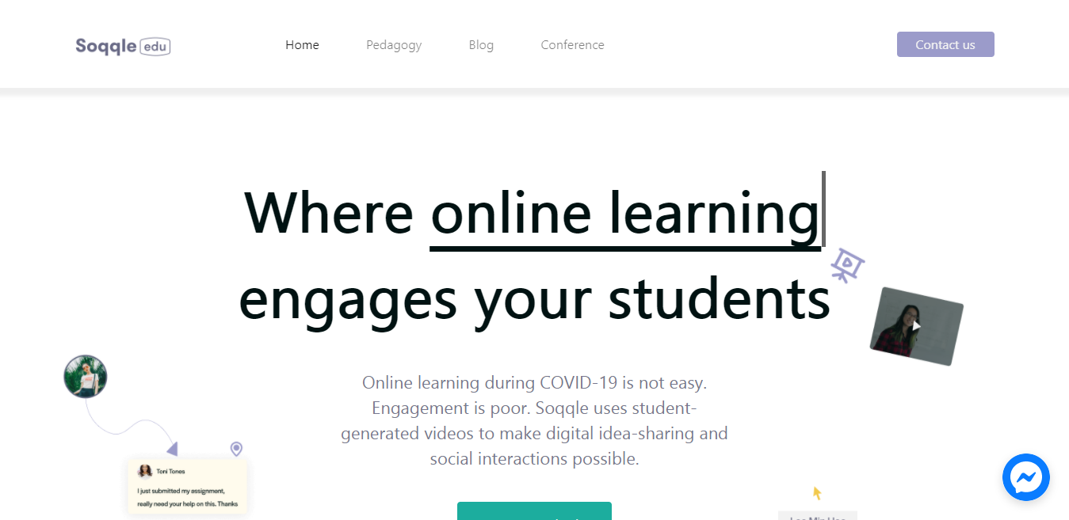
PROJECT #3
Soqqle
Soqqle
Education
We created a website where education becomes easy during COVID-19. Soqqle uses student-generated videos to make digital idea-sharing and social interactions possible.

Slide 33
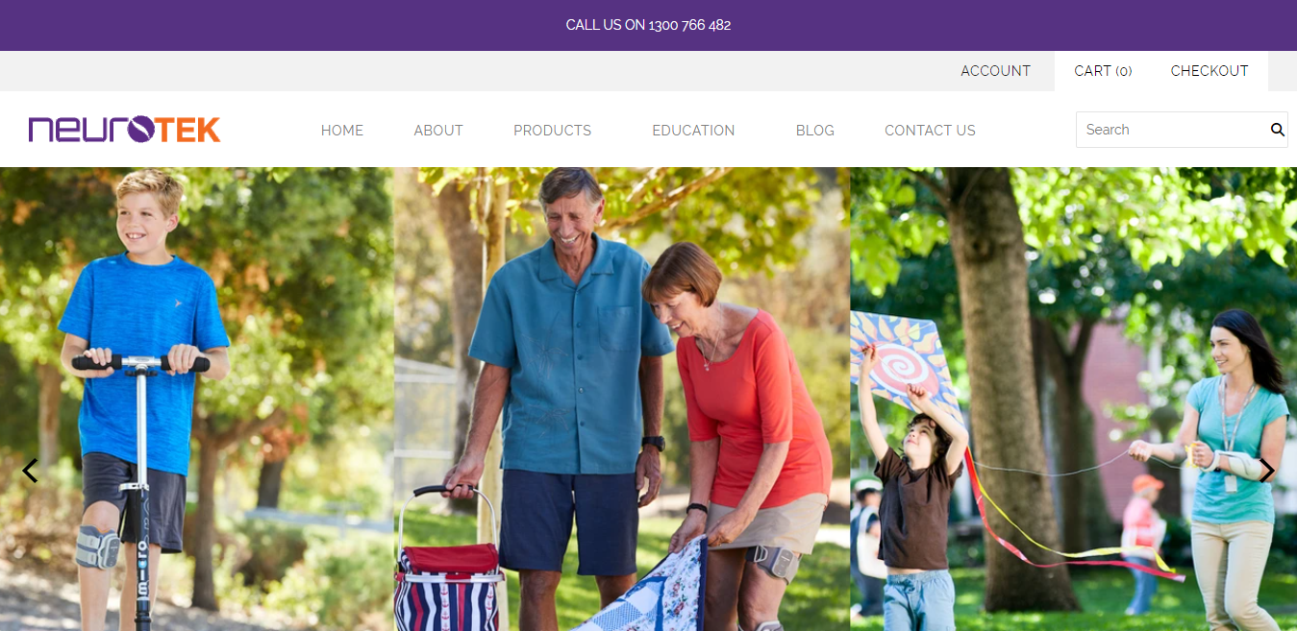
PROJECT #4
Neurotek
Neurotek
Health Care
Neurotek offers a specialised neurological concentrated product range and therapy service. We helped to show each and every service with details. Required sections and payment method implemented with total satisfaction.

Slide 34
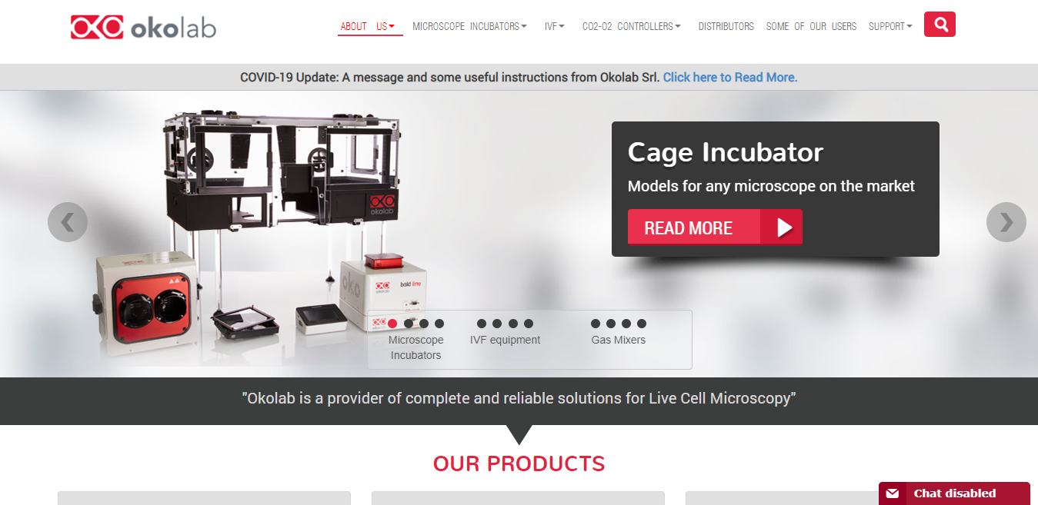
PROJECT #5
Oko Labs
Oko Labs
Health Care
We created a platform with design, production, sales and customer care. Okolab is at the leading edge of bio-medical research with sound experience in the field of microscopy and mechanical engineering.

Slide 35
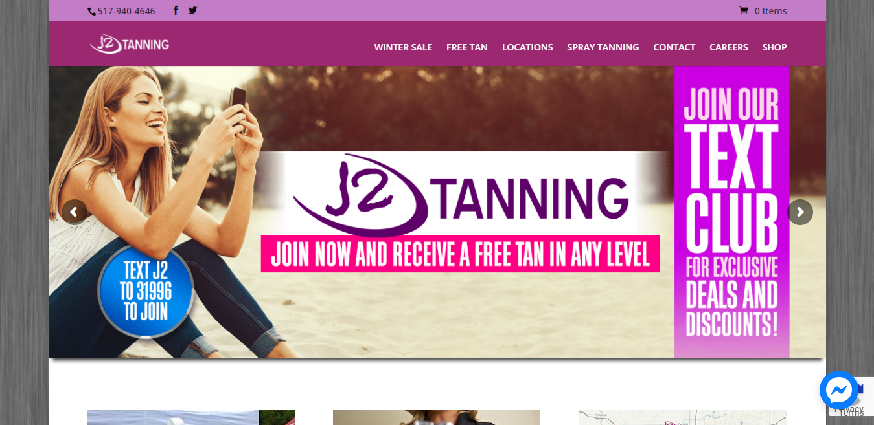
PROJECT #6
J2 Tanning
J2 Tanning
Management
We delivered the best outcome as they required for showing their services, career availability, Free tan process and recent sales offers. J2 Tanning provides the best tan service with new spray tanning.

Slide 36
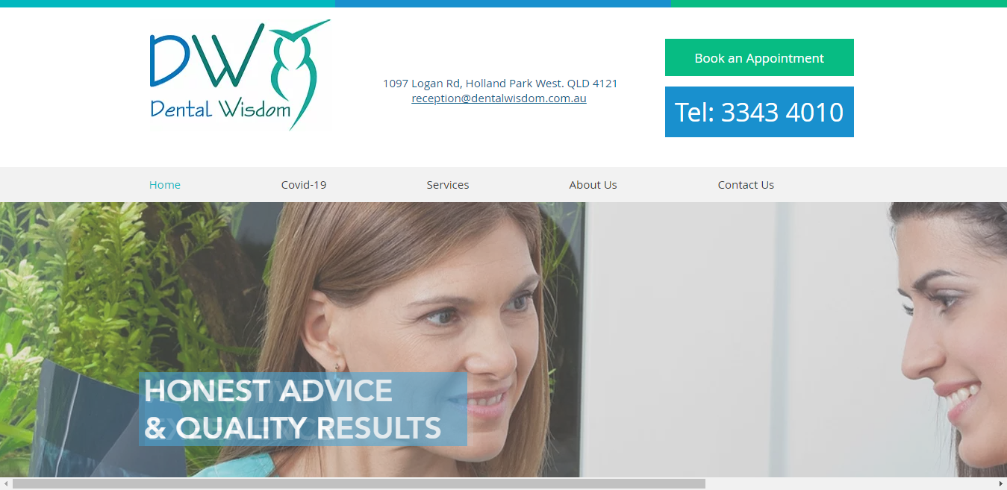
PROJECT #7
Dental Wisdom
Dental Wisdom
Communication
Dental Wisdom is a family dental practice located in Holland providing oral health services. We provided upfront advice and development with establishing the perfect solution to the front end interface.

Slide 37
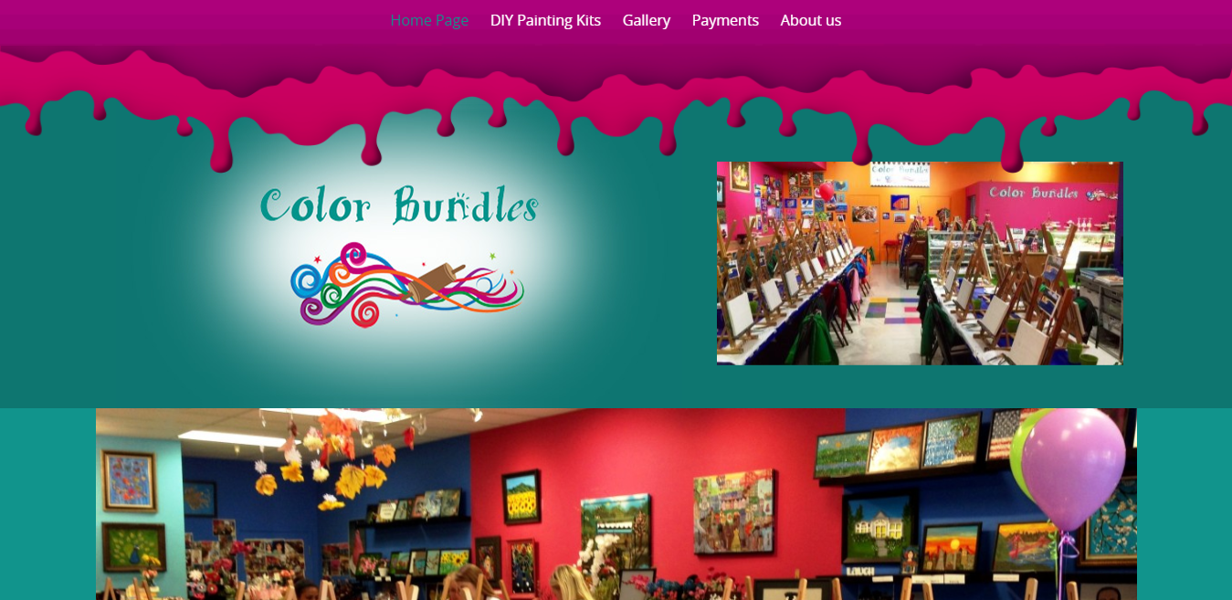
PROJECT #8
Color Bundle
Color Bundle
Travel
Dental Wisdom is a family dental practice located in Holland providing oral health services. We provided upfront advice and development with establishing the perfect solution to the front end interface.

Slide 38
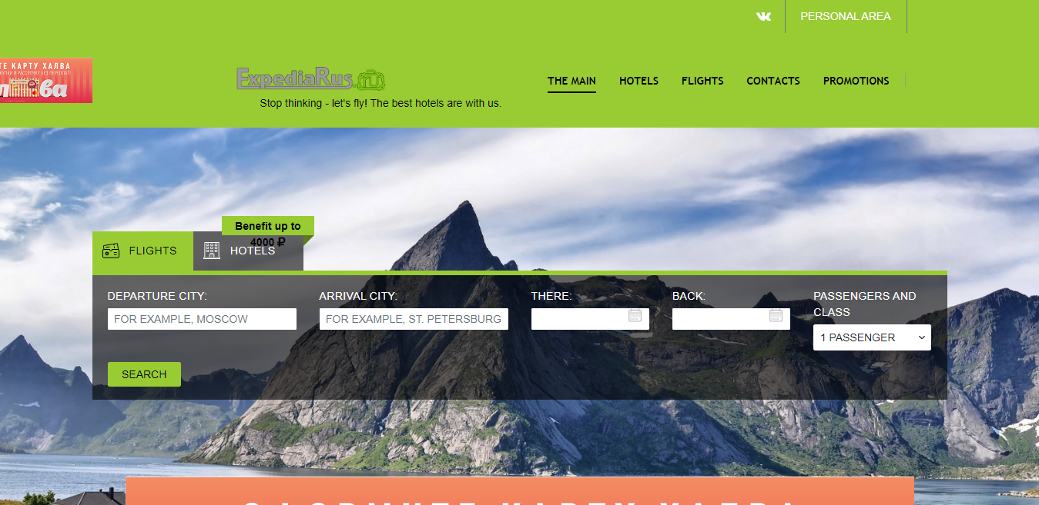
PROJECT #9
Expedia Rus
Expedia Rus
Travelling
Expedia Rus service allows you not only to choose an air destination and book your ticket, but also to organize a complex trip in all directions. Helping the platform to deliver what they require to fulfill their users.

Slide 39
MOBILE APP
PROJECTS

Slide 40

PROJECT #1
Rodo Insurance
Rodo Insurance
Finance & Insurance
We build a platform where you can choose your vehicle coverage while comparing them to others. We helped them creating different API's and integrated Logo and app design. With our design and development endeavors, created this responsive insurance app and website design.

Slide 41
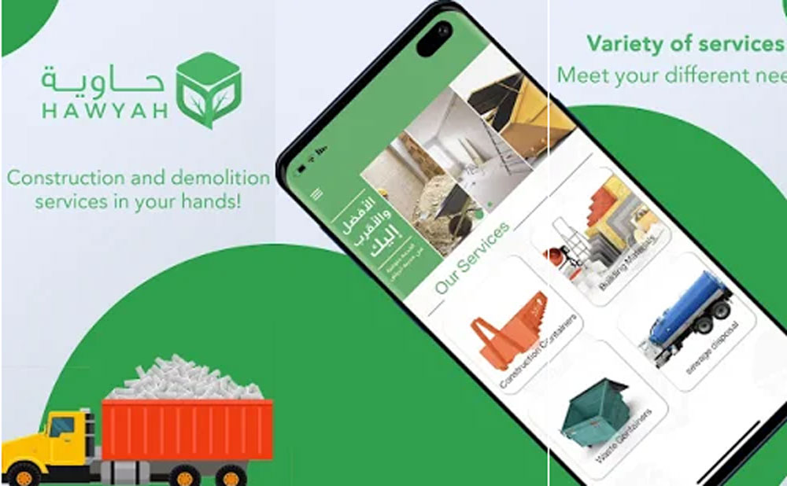
PROJECT #2
Hawyah
Hawyah
Delivery
We created this app to find the delivery options nearby you to get your order and order status at home. It consist of different API's and maps data to know user's locationa and nearby areas. getting the most important factor of e-commerce to one plca where you can choose the delivery guy.

Slide 42
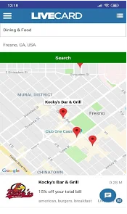
PROJECT #3
The LiveCard
The LiveCard
Shopping
With LiveCard app you can easily search and redeem offers. Local and global location offers with your phone. Creating these apps is challenging and yet most enjoying work to do. We integrated API with phone number and using React native component.

Slide 43
TECHNOLOGIES PVT. LTD.
THANK YOU
Notes:
Links:
https://www.pexels.com/photo/people-near-table-3184639/

